Slide 1




Conference report
Didi Amar

Slide 2
Conference outline
DREAM: reverse engineering challenges
RICCI: Conference on cancer informatics
RECOMB satellite on systems biology
RECOMB satellite on regulatory genomics
Partnership with Genome research and Journal of computational biology.

Slide 3
Systems biology talk
Inferring biological progression from high dimensional data
Sylvia K. Plevritis
Department of Radiology. Stanford University. Stanford, CA, USA.

Slide 4
Outline (Qiu et al. 2011)
Discover patterns of biological progression underlying microarray gene expression data.
Presented a method called Sample Progression Discovery (SPD).
SPD aims to organize the samples by the underlying progression and to identify the subsets of genes that are responsible for the progression.

Slide 5
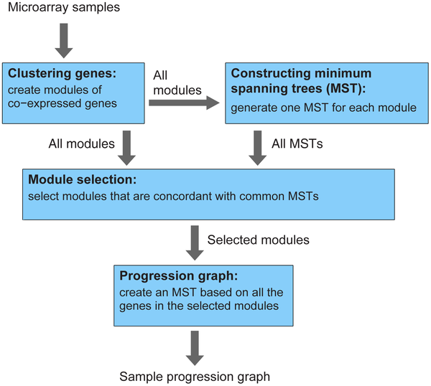
Algorithm flow

Slide 6
Clustering genes
Used an iterative version of Kmeans with Pearson correlation.
In each iteration, the domain is clustered with k=2, repeatedly with random starting points (200).
Construct a new matrix. For every gene, we keep a vector with it’s assignments.
Finally we use Kmeans again to cluster the new matrix.
Stopping criteria 0.7.
Finally merge initial clusters if their avergae correlation is above 0.9.

Slide 7
MST vs. modules
For every module, construct the MST between the samples using Euclidean distance.
For every gene module and a MST we check if they fit. This is done by testing if the distances between samples that are connected are small. To evaluate this, they used a simple empirical test (selecting random trees).
Finally we are interested in common MSTs.

Slide 8
Global MSTs
We define a “similarity” score between modules to be the number of shared trees.
We use this modules similarities to find clusters of modules.
Modules were clustered manually using this score.
Finally, the predicted progression pattern is built based on MST of the genes in the selected modules.

Slide 9
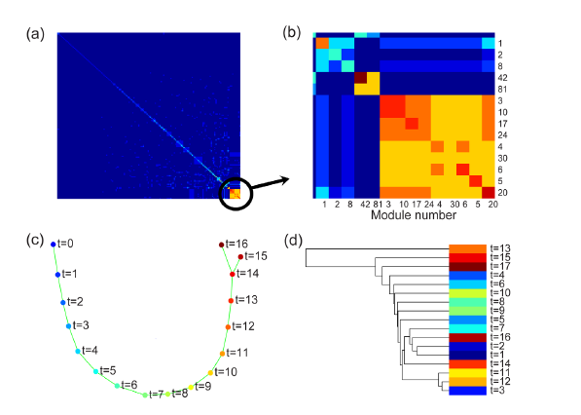
Results on cell cycle data
Cell cycle data, the method was applied on the most variation genes (>3000 genes)
Initially: clustering detected 154 modules
These 9 modules has a similar MST
The global MST
Standard HC

Slide 10
Results – B cells
Applied the method on B-cells data: 44 samples across 5 normal differentiation stages and one malignant stage.
Normal stages include: hematopoietic stem cells, proB, preB, immature B, terminally differentiated B.
Malignant: preB ALL cells.

Slide 11
Results
Bootstrap tests show that the method is robust – that is, the resulting global trees are very similar when randomly down-sampling genes.
On all samples, SPD selected 10 gene modules, covering 2388 genes (on ‘global cluster’).
This group was enriched with:
  Proliferation genes (1E-12)
  B cell receptor pathway (1E-7).

Slide 12
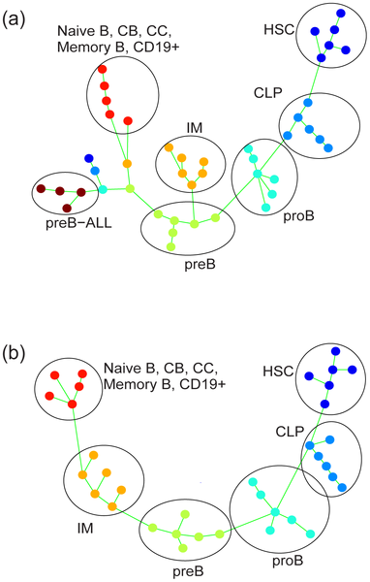
Results

Slide 13
RICCI talk
Characterization and interpretation of MPNST-associated transcriptional imbalances
Gel, B. 1; Mehta, T. 2; Terribas, E. 1; Mercadé, J. 3; Serra, 1; NF1 Microarray Consortium 4
1. IMPPC, Badalona;
2. University of Alabama at Birmingham, Birmingham, Al, USA;
3. Greenaltech, Barcelona;
4. Nf1 Microarray Consortium, Cincinnati

Slide 14
Neurofibromatosis type
1 (NF1)
AKA von Recklinghausen disease.
A disorder caused by malfunction of the gene neurofibromatosis type 1 (NF-1).
  NF1 encodes neurofibromin.
  Produced by many types of cells.
  Schwan cells that produce neurofibromin, protect nerve cells.
  It is a tumor suppressor gene that appears to prevent cell growth by turning of the RAS proteins.
Patients can develop many different phenotypes including scoliosis (curvature of the spine), learning difficulties, eye problems, and epilepsy.

Slide 15
Neurofibromatosis type
1 (NF1)
Differences between patients make prognosis hard.
Patients tend to develop different types of tumors:
  Multiple dermal neurofibromas (dNFs)
  Plexiform neurofibromas (pNFs)
  Malignant peripheral nerve sheath tumors (MPNSTs)
MPNSTs are common (8-13% of the cases) and are the leading cause of mortality: 21% survival rate within 5 years.

Slide 16
In this study
Analysis of expression profiles from dNFs, pNFs and MPNSTs to find MPNSTs specific differential genes.
SNP array analysis of MPNSTs vs. cell lines.
Crossed the results with long range epigenetic silencing data from prostate cancer.
(It was not explained why prostate cancer data is expected to fit here…)

Slide 17
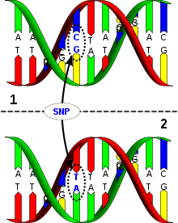
SNP
Single nucleotide polymorphism: a variation in a single site in DNA (coding or non coding).
The most frequent type of variation in the genome.
>10 million SNPs have been identified in human.
Almost all have only two alleles.
Many SNPs are associated with known diseases.

Slide 18
SNP arrays
Large scale analysis of >100,000 SNPs.
For each SNP this tool will tell us what are the alleles in a specific sample (AA, Aa, or aa).
Raw data can be used to analyze chromosomal aberrations, for example duplications or loss of heterozygocity (LOH).

Slide 19
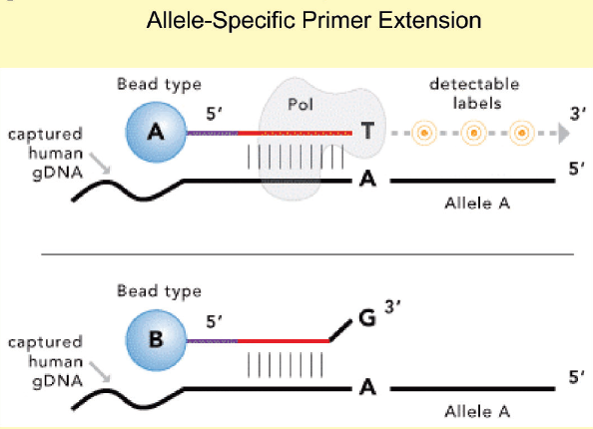
SNP arrays
One Illumina technology for example:
Two probes for the same SNP
After the hybridization step, extension will occur only in one allele.

Slide 20
Raw data
For each SNP, we use the raw intensities of the two alleles and transform the results to polar coordinates. We get two parameters:
  Normalized intensity (R) for each sample
  Allele frequency (Theta): 1,0 = homozygote (the same allele), ~0.5 = heterozygote.

Slide 21
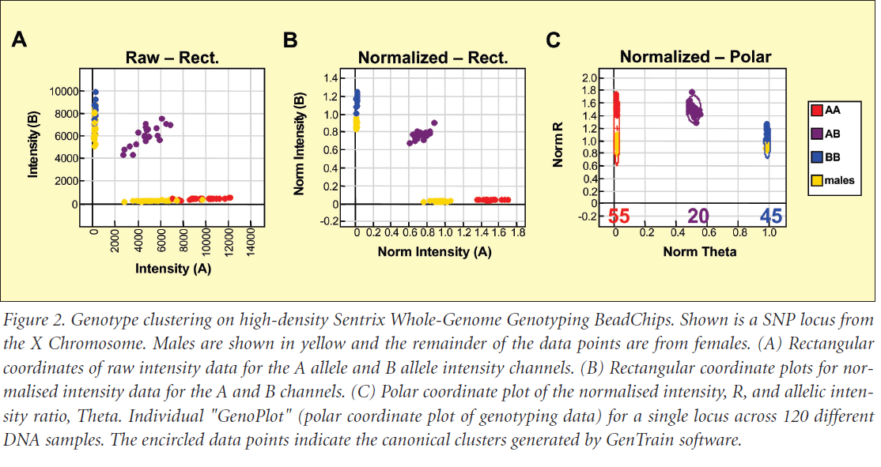

Slide 22

Detecting aberrations
Done by comparing normalized intensities to a reference sample; we can use for example samples from purified homozygote WT, or we can compare the two parameters shown in preceding slide with the other samples.

Slide 23
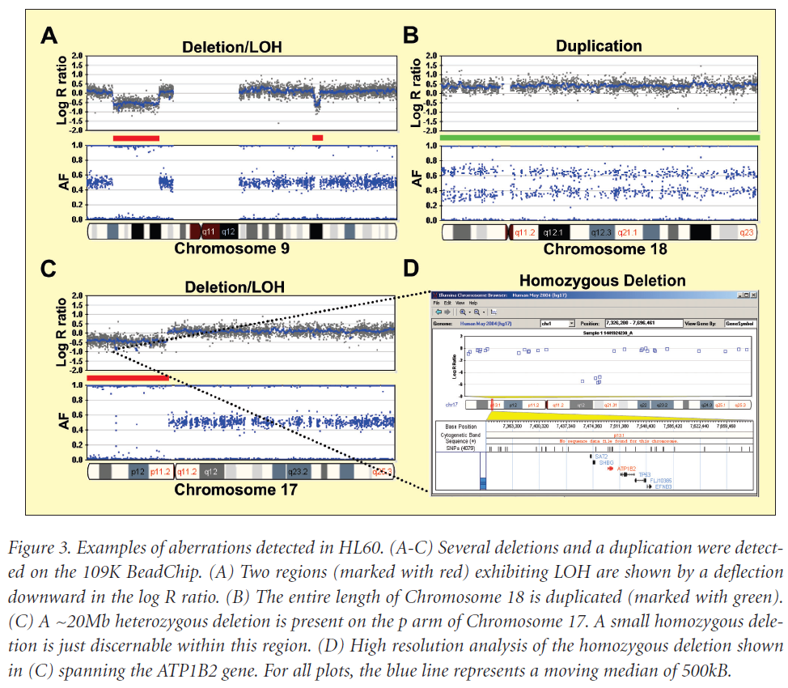
Examples
Duplication of one chromosome area, now the AF is 1/3 and 2/3
Example of LOH of a large area and a complete loss of one gene within

Slide 24

Epigenetics
‘Epi’genetics - ‘On’ or ‘over’ the genetic information encoded in the DNA
Changes in cellular phenotype that are not caused by changes in DNA sequence.
A different layer of transcriptional regulation
Influence gene expression
Includes histone modifications and DNA methylation

Slide 25
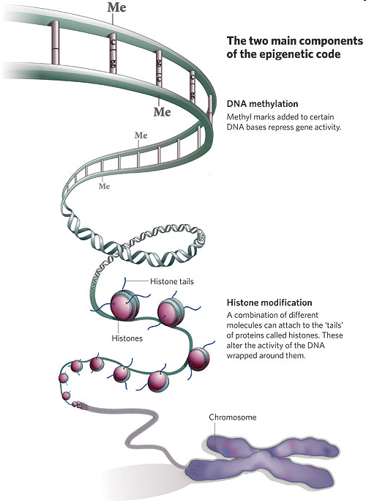
Chromatin
Nucleosome Basic unit = 147pb wrapped around Histone octamer 2X H2A H2B H3 H4
Histone C-terminal domain, N-terminal tail

Slide 26
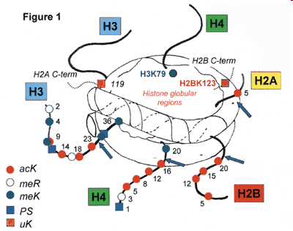
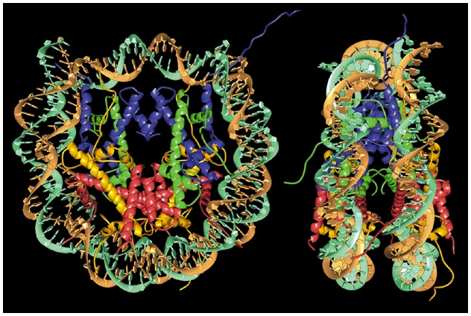
What are histone modifications?
Covalently attached groups (acetyl, phospho, methyl, ubiquitin, SUMO), usually to histone tails
Reversible: enzymes that add/remove modification, signals
Dynamic
Have diverse biological functions: in chromatin organization, gene expression, DNA repair
Lodish et al., 2000
Cell, 111:285-91, Nov. 1, 2002
Notes:
26

Slide 27
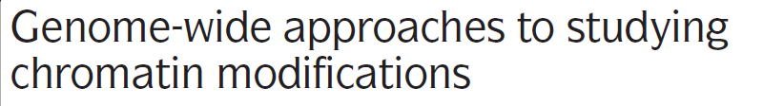

Histone modifications are
among a number of chromatin
changes (DNA methylation,
nucleosomal positioning,
small RNAs) that regulate
gene expression and epigenetic fate

Slide 28
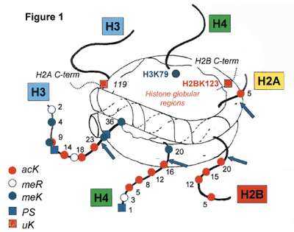
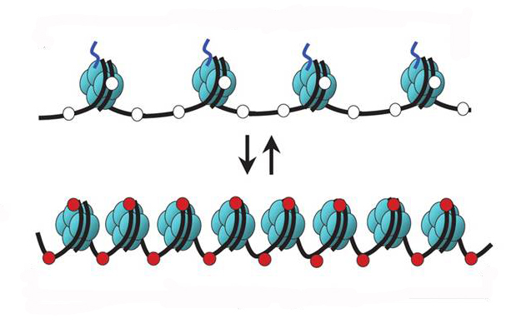
Histone modification regulates accessibility to gene promoter regions
  Acetylation and Methylation regulate accessibility to promoter regions of genes
Transcriptionally active chromatin
Transcriptionally repressive chromatin
Notes:
Regulate the accesso al promotore

Slide 29
How are histone modifications studied?
Chromatin immunoprecipitation (ChIP), followed by PCR (targeted) or by genome-wide approaches:
    Targeted approach – ChIP-qPCR
    Unbiased approach – ChIP-chip, ChIP-seq, or other genome-wide techniques
    Limitations:
        Antibody specificity
        Inherent biases of localization methods
Mass Spectrometry:
    Requires digestion of histones

Slide 30
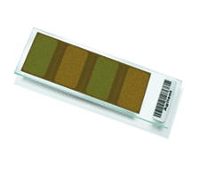
Strategy for localizing histone marks by ChIP-qPCR or ChIP-chip
(usually normalized to input DNA)
QPCR
Purify DNA
Crosslink proteins to
DNA
Fragment
(Sonication or
MNase digest)
Chromatin
Immunoprecipitation
(ChIP)
Amplify DNA
Label
Hybridize to DNA chips
Enrichment
Peak
Scan
Analyze
Normalize
Map to genome
Gene X
Notes:
30
To answer this question we used genome-wide ChIP-chip, which is chromatin immunoprecipitation followed by hybridization to densely tiled DNA arrays, which represent the entire non-repetitive mouse genome sequence.
Briefly, we crosslink the cells. (For all experiments I will discuss, I used differentiated 3T3-L1 adipocytes). Then we fragment the chromatin by sonication, followed by IP with specific and control abs, followed by purficitation, limited amplification, labeling, and hybridization of the DNA. After the chips are scanned, we analyze, normalize and validate the data. What we obtain finally are enrichment peaks of ~ 1000bp length with the txn factor binding site most likely located in the middle. So for the remainder of my talk I will refer to these enrichment peaks as binding regions, which indicates the entire region of enrichment.
So at this level of analysis we don’t know the exact 13bp sequence to which PPARγ binds but we have a very good general idea of where the binding occurs and how it localizes relative to known genes. Shown here are two examples.

Slide 31
Strategy for localizing histone marks by ChIP-seq
Local amplification
Massively parallel sequencing

Slide 32
What do ChIP-chip and ChIP-seq data look like?
Mikkelsen et al., 2007

Slide 33
LRES
Long-range epigenetic silencing.
Promoter hypermethylation and subsequent silencing of transcription factors can lead to further deregulation of their targets.
It was shown in colorectal cancer that a group of transcription factors are hypermethylated, this group is a part of LRES region.

Slide 34
The flow
Use GE to find differential genes
Cluster according to genetic location (used Local adaptive procedure with permutation tests).
Use the SNP arrays to detect copy number aberrations, explain the differential gene clusters using this data.
Match discrepancies using LRES data (since this is probably due to epigenetic changes)

Slide 35
Results
14 out of 15 up-regulated gene clusters were explained using the copy number data.
In the down-regulated cases the coverage was less – 15 out of 24 clusters.
Some of the down regulated clusters were explained by LRES, specifically one cluster had copy number gains but was silenced in the LRES data.

Slide 36
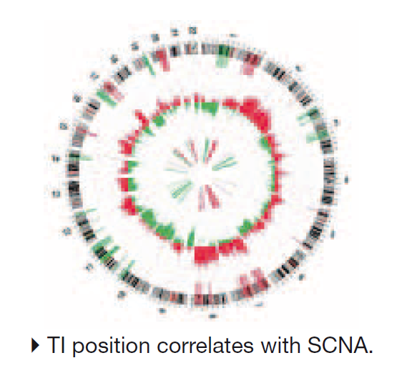
Results

Slide 37
My questions…
Can we use these data to build a global model instead of clustering? That is, we can try to build a model that predicts GE based on gene features and the additional genomic data.
I would start with simple decision tree algorithms to see if we can build a simple and interpretable model…

