Slide 1
Finding disease specific signatures in blood gene expression data
Group meeting Jan 2011

Slide 2
The blood gene expression gold mine
Without cancer data sets.
More than 15 different diseases.
At least 4 different chip types.
More than 2000 samples.

Slide 3
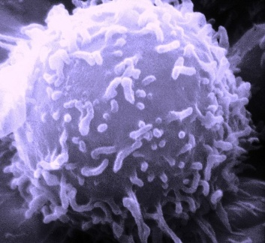
Biological Aspects
Most of the data sets contains expression levels of peripheral blood mononuclear cells (most of the adaptive immune system and part of the innate immune system).
We assume that immune system cells in the circulation absorb a unique signal.
Since blood can show general “sickness” signal the usual cases vs. controls analysis is not enough.

Slide 4
Machine Learning

Slide 5
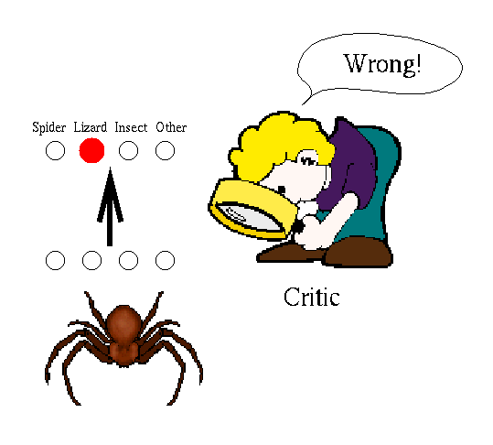
Supervised Learning
Given: Training examples (x; f(x)) for some unknown function f
Find: A good approximation to f.
Disease diagnosis
x: Properties of patient (symptoms, lab tests)
f(x): Disease (or maybe, recommended therapy)
Face recognition
x: Bitmap picture of person's face
f(x): Name of the person.
Spam Detection
x: Email message
f(x): Spam or not spam.

Slide 6
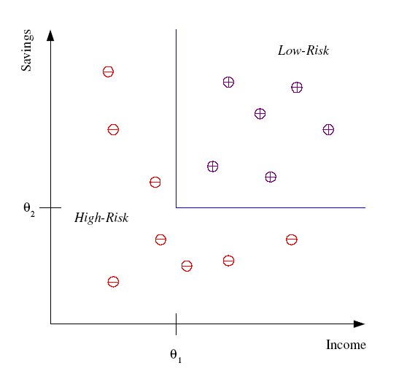
Classification example
Example: Credit scoring
Differentiating between low-risk and high-risk customers from their income and savings
Discriminant: IF income > θ₁ AND savings > θ₂
THEN low-risk ELSE high-risk

Slide 7
Feature Selection
Thousands of low level features (genes): select the most relevant one to build better, faster, and easier to understand learning machines.
n
n’
X
m

Slide 8
FS Nomenclature
Univariate method: considers one variable (feature) at a time.
Multivariate method: considers subsets of variables (features) together.
Filter method: ranks features or feature subsets independently of the predictor (classifier).
Wrapper method: uses a classifier to assess features or feature subsets.
Embedded method: FS is embedded in model learning.

Slide 9
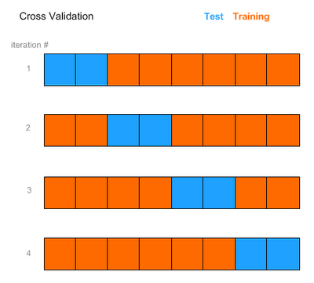
Testing a model
We will use cross validation.
FS is part of the learning scheme, therefore we select features for each fold separately.
We will use two evaluation scores:
Accuracy (% correct predictions)
Area Under The ROC curve.

Slide 10
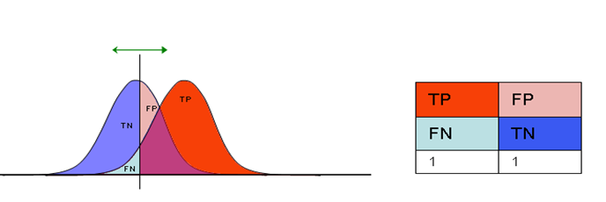
Receiver operating characteristic (ROC)
score given by the classifier

Slide 11
Receiver operating characteristic (ROC)
1
μ-
μ+
ROC curve
TPR
AUC
-1
0
FPR
1
σ-
σ+
Classifier’s Score

Slide 12
Vertex Cover
A vertex cover of a graph G is a set C of vertices such that each edge of G is incident to at least one vertex in C. The set C is said to cover the edges of G.
Finding the minimal VC is NPH, but one can find a factor-2 approximation by repeatedly taking both endpoints of an edge into the vertex cover.

Slide 13
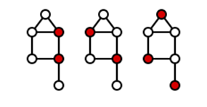
Dominating Set
A dominating set for a graph G = (V, E) is a subset D of V such that every vertex not in D is joined to at least one member of D by some edge.
This problem is also NPH, we will use the greedy heuristic.

Slide 14
Motivation
A multivariate FS algorithm that outputs a signature of genes for each class.
We want an algorithm that determines the number of genes in each signature i.e. not a ranker.

Slide 15
Main Assumption
Denote Corr(D,g1,g2) as the Pearson correlation between two gene patterns g1 and g2 in the disease D.
If a gene g participates in a given disease’s (D) unique signature then there exists another gene g’ and the following holds:
a. Corr(D,g,g’) is significantly high.
b. For every other class C, Corr(C,g,g’) is significantly low.

Slide 16
FS Algorithm outline
For every class C we create a non weighted graph G(C). Vertices are genes, we add and edge (u,v) if Corr(C,u,v) is > and for every other class C’ Corr(C’,u,v) <
The unique signature of C is the VC\DS of G(C).
Finally unite all signatures and output the set of genes.

Slide 17
Example for one signature
Binary case, a is 0.8 (high correlation in the cases), edges:

Slide 18
Example for one signature
Binary case, b is 0.2 (low correlation in the controls), edges:

Slide 19
Example for one signature
The final graph.

Slide 20
Example for one signature
The final graph.

Slide 21
Determining parameters
Determining constants a and b is problematic since correlation tends to decrease as the number of conditions increase.
We will use non-parametric statistics procedures for setting these thresholds.

Slide 22
SAM procedure (Tibshirani 2001)
Input: A list of scores (correlations, t-statistic) from ‘real’ data, a list generated using a randomization process, and a FDR bound α.
Output: A significance threshold, assuring a low FDR (bellow α).
For a given threshold d, the FDR estimation is:

Slide 23
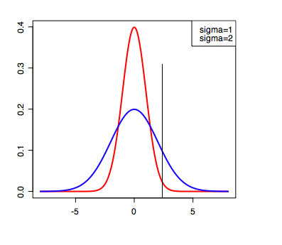
SAM procedure
For a given threshold d, the FDR is bounded by:
Choose the first threshold d’ for which the estimated FDR is bellow α

Slide 24
Determining parameters
We create randomized data set for every class by shuffling each gene’s values.
We will use the SAM procedure for estimating a threshold for significant correlation for a given class.
We will use the 2/3 order statistic of the data correlations as a non significance threshold.

Slide 25
Results – Data Sets
Scherzer 2007
3 classes:50 PD patients, 22 Healthy controls and 33 other neurodegenerative diseases patients.
Intensity filter leaves ~14000 probes.
Chaussabel 2008
7 classes, different diseases without healthy controls.
Intensity filter leaves ~9000 probes.

Slide 26
Results-Algorithms comparison
Univariate FS algorithms: Chi Square, Information gain.
Multivariate FS algorithm: SVMRFE (Guyon 2002), CfsSubsetEval (Hall 1998).
Number of selected features: 100,200,…,500.
Classifiers: SVM and FS embedded logistic classifier.

Slide 27
Results-Scherzer
5 fold CV results
Top 4 of other algorithms
PD vs. All others
R.O.C | Accuracy | Classifier | # Features | FS algorithm
0.7 | 62 | Logistic | 500 | InfoGain
0.66 | 66.7 | SVM | 500 | Chi
0.64 | 64.2 | Logistic | 500 | Chi
0.66 | 60 | SVM | 300 | InfoGain
0.72 | 67.7 | Logistic | ~270 | 1E-5 FDR, VC

Slide 28
Results-Scherzer
5 fold CV results
Top 4 of other algorithms
Multi-class: PD, Ctrl and Neuro
R.O.C | Accuracy | Classifier | # Features | FS algorithm
0.635 | 56.2 | Logistic | 200 | Chi
0.65 | 56.2 | SVM | 400 | InfoGain
0.64 | 45.7 | Logistic | 400 | Chi
0.64 | 49.5 | SVM | 500 | Chi
0.68 | 54.3 | Logistic | ~400 | 1E-6 FDR DS
0.68 | 54.3 | SVM | ~400 | 1E-6 FDR DS

Slide 29
PD signature
299 probes were selected by VC.
Clustered into two groups (homogeneity 0.5, separation -0.92):

Slide 30
PD signature
KEGG enrichment analysis(0.2 bonferroni)
Cluster | Pathway name | #genes | Corrected p
Cluster_1 | Metabolic pathways | 22 | 0.049
Cluster_1 | Oxidative phosphorylation | 9 | 1.25E-04
Cluster_1 | Endocytosis | 8 | 0.02
Cluster_1 | Parkinson's disease | 6 | 0.071
Cluster_1 | Huntington's disease | 9 | 0.002
Cluster_2 | Pathogenic Escherichia coli infection | 5 | 3.77E-05
Cluster_2 | Tight junction | 5 | 0.005
Cluster_2 | Arrhythmogenic right ventricular cardiomyopathy (ARVC) | 4 | 0.004
Cluster_2 | Leukocyte transendothelial migration | 5 | 0.002
Cluster_2 | Adherens junction | 6 | 5.87E-06
Cluster_2 | Wnt signaling pathway | 4 | 0.132

Slide 31
PD signature
TANGO, location (0.1 FDR)
Cluster | Pathway name | #genes | Corrected p
Cluster_1 | organelle envelope - GO:0031967 | 17 | 0.001
Cluster_1 | mitochondrial part - GO:0044429 | 16 | 0.004
Cluster_1 | cytoskeleton - GO:0005856 | 24 | 0.004
Cluster_1 | cortical actin cytoskeleton - GO:0030864 | 4 | 0.008
Cluster_1 | anatomical structure formation - GO:0010926 | 16 | 0.053
Cluster_1 | plasma membrane part - GO:0044459 | 27 | 0.089
Cluster_2 | non-membrane-bounded organelle - GO:0043228 | 19 | 0.004
Cluster_2 | cytosol - GO:0005829 | 12 | 0.004
Cluster_2 | regulation of primary metabolic process - GO:0080090 | 20 | 0.032

Slide 32
Results-Chaussabel
5 fold CV results
Top 4 of other algorithms
Other FS algorithms selected up to 1000 features.
R.O.C | Accuracy | Classifier | # Features | FS algorithm
0.975 | 91.2 | SVM | 700 | Chi
0.975 | 90.7 | SVM | 900 | InfoGain
0.987 | 88.5 | Logistic | 800 | InfoGain
0.987 | 88.5 | Logistic | 300 | InfoGain
0.96 | 85 | SVM | ~550 | 2E-4 FDR DS
0.977 | 90.7 | SVM | ~1200 | 1E-3 FDR DS

Slide 33
Conclusions
A method for FS, that determines the number of selected features.
We can classify GE data using correlations only, i.e. without examining the actual values.
It seems that for PD (and other diseases) a ‘secondary’ signal appears in the blood.
This method is pretty slow compared to uni-variate methods, but faster than other multivariate methods.

Slide 34
Discussion
Re-Analyze Scherzer’s data set without the 5 outliers.
Try this method on more data sets, any suggestions?
A better statistical test for significance of un-correlation?
Instead of using VC or DS we can rank genes by degree and select top K.
Adding external information?

