Slide 1
Neuroinformatics 2011 INCF (International Neuroinformatics Coordinating Facility)
Boston 4-6/9/2011

Slide 2
About the conference
INCF is an international organization devoted to advancing the field of neuroinformatics. The annual INCF Congress provides a meeting place for researchers in this emerging field.
~200 participants of diverse backgrounds.
Two talks:
1) Keynote given by Allan Jones from the Allen institute for brain research
2) A workshop on “Macroconnectome” – connecting different modalities.

Slide 3
Allen institute
Talk by Dr. Allan Jones
Allen Institute for Brain Science Seattle, USA.
Free, publicly available tools and data for neuroscience research.
Integrate genomic and anatomic information, as well as sophisticated data search and viewing tools.
Allows access to details and patterns of gene activity throughout the brain.
The Human Genome Project established what the genes are. Allen Institute’s public resources take a critical next step toward understanding their biological functions by revealing where they are expressed, or “turned on,” in the brain.
Christof Koch

Slide 4
Allen Institute
On line atlases combine extensive genomic and anatomic data:
- Mouse brain atlas: a comprehensive genome-wide map of the adult mouse brain revealing where each gene is expressed
- Spinal cord atlas: a unique genome-wide map revealing where each gene is expressed, or “turned on,” throughout the adult and juvenile mouse spinal cord
- Developing mouse brain atlas: provides a four-dimensional map detailing gene expression across the three dimensions of space as well as time.
- Human brain atlas – will be discussed next
Other significant projects related to the study and understanding of the brain.

Slide 5
Allen human brain atlas
Since May 2010
Goal: provide insights that propel researchers to understand and discover new treatments for a variety of brain diseases and disorders, including Alzheimer’s disease, autism, schizophrenia and drug addiction.
a comprehensive brain- and genome-wide three-dimensional map of the human brain that details where in the brain each gene is expressed, or “turned on.”

Slide 6
Allen human brain atlas
Tissue collection within 24 hs. after death.
MRI, DTI (Diffusion tensor imaging ), psychiatric rep, narcotic rep.
1,000 distinct brain areas constituting complete anatomic coverage were sampled from each brain (so far 2 brains available, 2 more under analysis). Histology and samples for GE analysis.
Each sample is examined using microarray profiling or refseq.
selected genes of significant interest are more precisely mapped within key brain structures using in situ hybridization
Allan Jones_ A map of the brain.flv
Notes:
Start movie after 6 min for procedure
Diffusion MRI is a magnetic resonance imaging (MRI) method that produces in vivo images of biological tissues weighted with the local microstructural characteristics of water diffusion, which is capable of showing connections between brain regions.^{[1]} The field of diffusion MRI can be understood in terms of two distinct classes of application—diffusion weighted MRI and diffusion tensor MRI. Diffusion MRI is a key technology in the creation of the human connectome, which is the structure and organization of the connections throughout the central nervous system.^{[2]}
Diffusion tensor imaging (DTI) is important when a tissue—such as the neural axons of white matter in the brain or muscle fibers in the heart—has an internal fibrous structure analogous to the anisotropy of some crystals. Water will then diffuse more rapidly in the direction aligned with the internal structure, and more slowly as it moves perpendicular to the preferred direction. This also means that the measured rate of diffusion will differ depending on the direction from which an observer is looking.

Slide 7
Allen human brain atlas
Found 150 genes exhibiting significant differential expression between different brain areas.
Problem: small number of brains
Relatively good correspondence between the two brains.
Brain Explorer 2 - a desktop software application for viewing the human brain anatomy and gene expression data in 3D

Slide 8
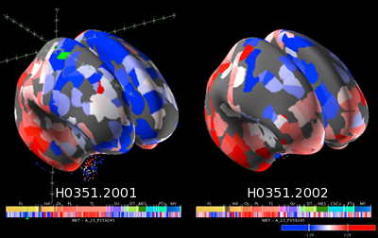
Brain explorer 2 – key features
A fully interactive 3D viewer of the Allen Human Brain Atlas
Allows viewing expression data in 3D: inflated cortical surfaces are colored by gene expression values of nearby samples.
Allows viewing expression data from different donors side-by-side.
Explore anatomically-labeled MRI images and cortical surfaces.
Investigate probes or samples of interest in more detail with direct links back to the Allen Human Brain Atlas web page.
Tutorial_ Brain ExplorerÂ® 3-D Viewer for the Allen Human Bra.flv
Notes:
Understand the picture

Slide 9
Additional projects
The NIH Blueprint Non-Human Primate (NHP) Atlas is a map of gene expression in the developing rhesus macaque brain (brains taken at ages 0,3,12,48 months).
BrainSpan project – joint with Yale, UCSC Human fetal atlas under development (15-25 weeks). Includes epi-genetics and SNPs.
Sleep mouse brain atlas
Mouse brain connectivity atlas.
Christof Koch– joined as chief scientific officer. Starting a consciousness project using mice.

Slide 10
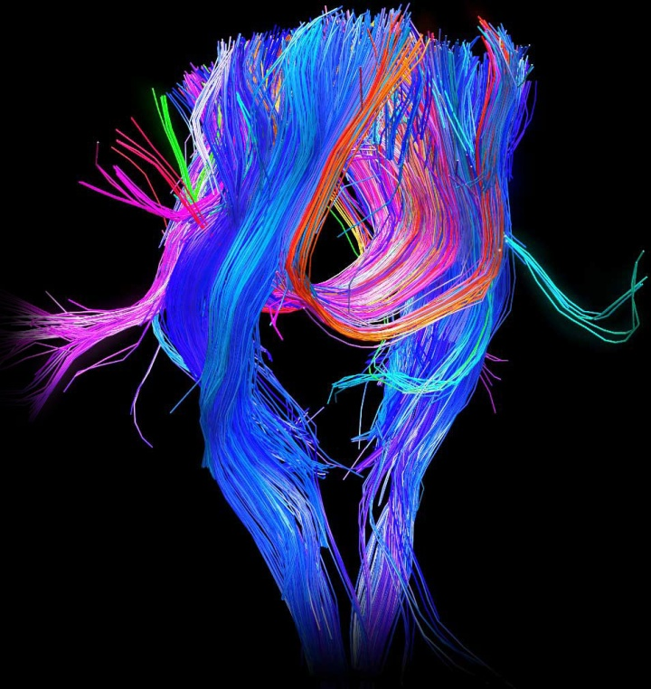
Human Connectome Project
The Human Connectome Project (HCP) aims to construct a map of the complete structural and functional neural connections in vivo within and across individuals.
A collaboration between MGH (Massachusetts General Hospital) and UCLA.
Connectivity viewer http://www.humanconnectomeproject.org/data/relationship-viewer

Slide 11
Connectome goals
1) Develop sophisticated tools to process high-angular diffusion (HARDI) and diffusion spectrum imaging (DSI) from normal individuals to provide the foundation for the detailed mapping of the human connectome
2) Optimize advanced high-field imaging technologies and neurocognitive tests to map the human connectome
3) Collect connectomic, behavioral, and genotype data using optimized methods in a representative sample of normal subjects
4) Design and deploy a robust, web-based informatics infrastructure
5) Develop and disseminate data acquisition and analysis, educational, and training outreach materials.
Notes:
Disseminate = להפיץ

Slide 12
The contribution of resting-FMRI connectivity to the connectome
Dr. Stephen Smith – Oxford university
Resting state functional MRI (R-fMRI) is a relatively new and powerful method for evaluating regional interactions that occur when a subject is not performing an explicit task.
Low-frequency (<0.3 Hz) BOLD fluctuations often show strong correlations at rest even in distant grey matter regions
Notes:
Resting state functional MRI (R-fMRI) is a relatively new and powerful method for evaluating regional interactions that occur when a subject is not performing an explicit task. Low-frequency (<0.3 Hz) BOLD fluctuations often show strong correlations at rest even in distant grey matter regions. Fluctuations in spontaneous neural activity are presumed to underlie the BOLD fluctuations, though the exact mechanisms giving rise to the neural fluctuations remain unclear. The spatial patterns of R-fMRI correlations are stable, in that they are similar across multiple ‘resting’ states, such as eyes-open, eyes-closed, and fixation, and across individuals and sessions. From experiments in the macaque monkey, R-fMRI correlations often overlap with known anatomical pathways, but they sometimes involve regions that are not directly connected. Hence, functional connectivity (R-fMRI) and anatomical connectivity (tractography) are complementary yet related measures that together provide a powerful approach to analyzing brain circuitry. A major goal of the human connectome project is to find an optimal combination of methods to parcellate brain regions and understand relationships between them, for example, using both seed-based approaches and independent component analysis approaches. In this talk I will give a brief background to resting-FMRI connectivity, the major methods used for analysing the data, and some cutting-edge advances in data acquisition and analysis techniques that are allowing us to find dynamic resting networks with ever-improving detail and richness.

Slide 13
Spatial patterns of R-fMRI correlations are stable, i.e. similar across multiple ‘resting’ states (eyes-open, eyes-closed, fixation) and across individuals and sessions.
Experiments in macaque monkeys show that R-fMRI correlations often overlap with known anatomical pathways, but sometimes involve regions that are not directly connected.
Functional connectivity (R-fMRI) and anatomical connectivity (tractography) are complementary yet related measures that together provide a powerful approach to analyzing brain circuitry.

Slide 14
Different approaches for FC: ICA (data driven clustering with no prior assumptions), ROI based FC.
Network approaches:
- Defining nodes can be anatomically or by functional percolation
- Defining edges: undirected measurements such as Pearson correlation, partial correlation, coherence, Baysian and directed measurements such as DCM (dynamic causal modeling), Granger causal modeling
Measurement evaluation: Pearson correlation – highest direct link sensitivity (DCM was found to have the lowess sensitivity).
New development – fMRI with TR=0.4 seconds

Slide 15
Cerebral connectivity at multiple scales: A network and a geometry
Dr. Van Weeden – MGH
To investigate the 3D structure of the fiber pathways of the brain, we obtained diffusion spectrum MRI in fixed whole-brain specimens of 11 mammalian species including 4 primates and analyzed their tractography.
DTI movie1 DTI movie2
Use 4.7T MRI
Defining the neighborhood of a pathway as the set of all pathways that approach within 1 voxel, we find such neighborhoods astonishingly well-organized, as parallel sheets of orthogonal pathways forming a 3D grid.
This grid structure encompasses continuously the cerebral white matter in all species.
Notes:
In neuroscience, tractography is a procedure to demonstrate the neural tracts.^{[1]} It uses special techniques of magnetic resonance imaging (MRI), and computer-based image analysis. The results are presented in two- and three-dimensional images.

Slide 16
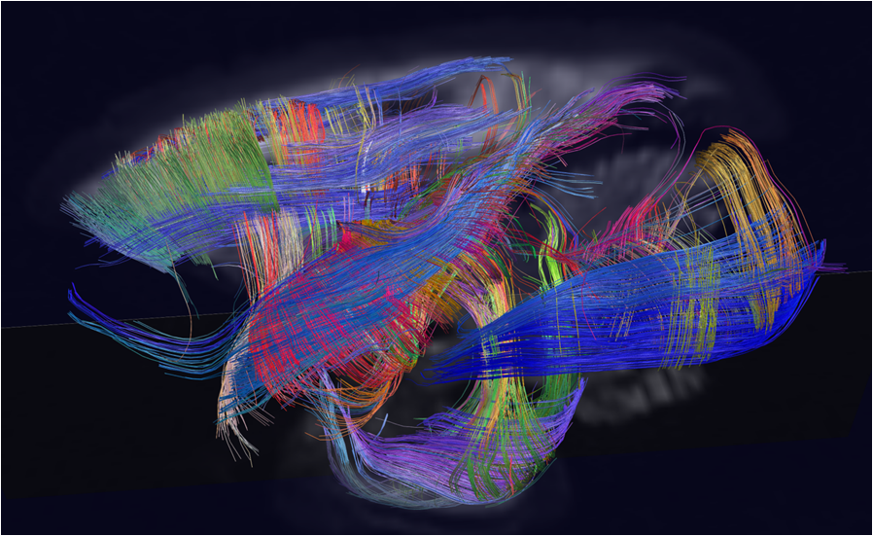
An example of grid structure in owl monkey left hemisphere viewed from the left

Slide 17
Linking the Human Connectome to the Genome: Informatics and Computational Approaches
Prof. Randy Buckner MGH
Information processing in the brain is accomplished by interactions among large-scale brain systems.
Distinct areas possess specialized microarchitecture, anatomic connectivity, and functional response properties
At the broadest level, information processing in the cerebral cortex arises from this large array of specialized areas and how they interact to transform and propagate information
Recent studies that have identified distinct large-scale brain systems in the human and dissociated their functional properties.
Properties of these pathways, and broad connectivity patterns across the cortex, can be measured efficiently in thousands of individual subjects and linked to genetic variation
We would like to build a resource to explore the genetic bases of individual differences in brain architecture that are relevant to normal variation and psychiatric illness.
Notes:
Information processing in the brain is accomplished by interactions among large-scale brain systems. Distinct areas possess specialized microarchitecture, anatomic connectivity, and functional response properties. At the broadest level, information processing in the cerebral cortex arises from this large array of specialized areas and how they interact to transform and propagate information. In this talk I will present a series of recent studies that have identified distinct large-scale brain systems in the human and dissociated their functional properties. I will illustrate how properties of these pathways, and broad connectivity patterns across the cortex, can be measured efficiently in thousands of individual subjects and linked to genetic variation. The goal of this developing work is to build a resource to explore the genetic bases of individual differences in brain architecture that are relevant to normal variation and psychiatric illness.

