Slide 1
Characterizing dynamic functional connectivity in the resting brain using variable parameter regression and Kalman filtering approaches
Kang J, Wang L, Yan C, Wang J, Liang X, He Y.
State Key Laboratory of Cognitive Neuroscience and Learning, Beijing Normal University, Beijing, China.
Neuroimage 56 (2011)

Slide 2
Background
Human brain activity depends on the functional connectivity of multiple brain regions that form specific functional brain networks.
Recent studies indicated that relationship between brain regions can be investigated by examining the functional connectivity of spontaneous blood oxygen level-dependent (BOLD) signals derived from resting-state functional MRI.
Most of these studies assume that inter-regional interactions are temporally stationary. However, little is known about the dynamic characteristics of resting-state functional connectivity (RSFC).

Slide 3
This work
Aims at detecting functional connectivity fluctuations within and between multiple known functional brain networks.
This is done by combining:
1) Variable Parameter Regression (VRP)
2) Kalman filtering approach (Kalman 1960, Garbade 1977, Digalakis and Rohlicek 1993)

Slide 4
Variable Parameter Regression (VRP)
If x_{t} = BOLD signal of voxels x in time t
And y_{t} = BOLD signal of voxel y in time t
Then: y_{t =} x_{t}β_{t +} u_{t} t = 1,……T
u_{t} ~N(0,σ²)
The dynamic evolution of β is assumed to follow a random walk with zero drift over time
β_{t =} β_{t -1} + p_{t} t=2,….T
p_{t} ~N(0,σ²P)

Slide 5
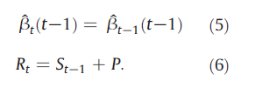
Parameter evaluation using Kalman filtering model
A mathematical method (Rudolf E. Kálmán)
Use measurements observed over time, which contain noise and other inaccuracies, to estimate the state of a system
In this case used to estimate the regression parameters
= an estimate of β_{t} based on observations 1 to t
σ²S_{t} = covariance matrix of
σ²R_{t} =covariance matrix of
Notes:
Applied previously to fMRI data by Buchel and Friston (HBM 6, 403-408, 1998)

Slide 6
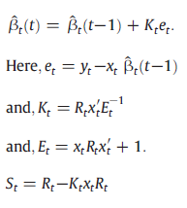
Kalman filtering model
The filter step revises this estimate of β_{t} by adding the new information contained in observation y_{t}

Slide 7
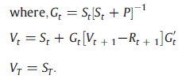
Kalman filtering model
The following smoothing step adds information that arrived after time t to the estimate of β_{t}

Slide 8
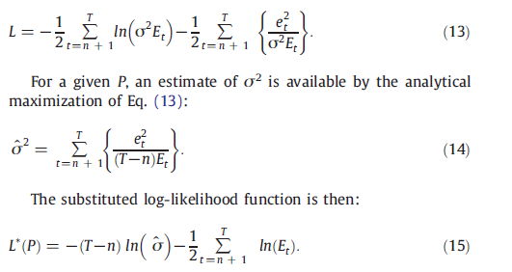
Kalman filtering model
P and σ² are estimated by maximum likelihood

Slide 9
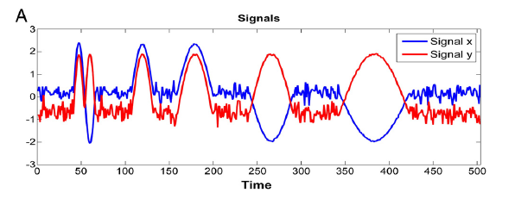
Application to simulated data
Two signals (x and y) were generated
504 time points each
Sinusoidal parts with normally distributed noise .
X and y signals, normalized with mean=0 and STD = 1

Slide 10
Results on simulated data
Pink = dynamic regression coefficient (β) with standard error
Green = linear regression coefficient (Pearson correlation)

Slide 11
Application on fMRI data
22 resting state fMRI data sets taken from the “Connectome“ database.
Healthy, right handed collage students (11 females), of age 17-24.
Static resting state functional connectivity maps were generated for 8 known resting state networks (RSNs), using a seed based correlation analysis (S-RSFC).
Maps were tested using one tailed one sample t-test and corrected for MTC (Monte Carlo)

Slide 12
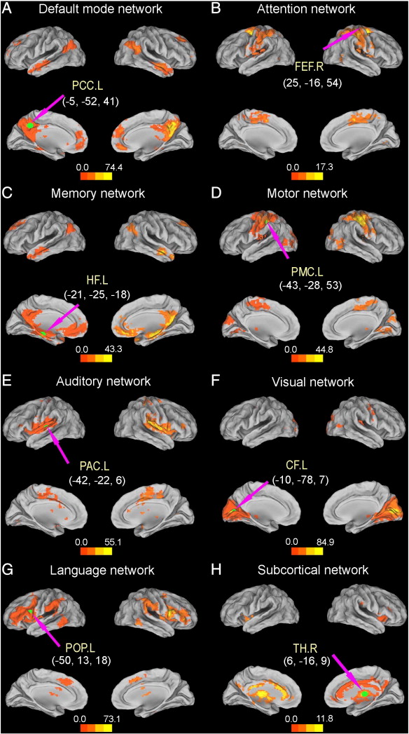
The positive correlation maps of the default-mode, attention, memory, motor, auditory, visual, language and subcortical networks during the resting state.
A group correlation map of each network was created using a one sample t-test, (p < 0.05, corrected).
The green circle and pink arrow of each map show the location of the ROI with the relevant MNI coordinates.
Notes:
???What do the numbers in the scale mean here?

Slide 13
Dynamic Resting State Functional Connectivity (D-RSFC) maps were evaluated
S-RSFC maps were used as masks to constrain D-RSFC maps.
Next regression coefficient were computed between the ROIs and all voxels in the mask.
8 movies were generated, demonstrating the time varying functional connectivity within each network.
Connectivity strength was calculated for each voxels by counting the number of time points with β significantly different from 0
Notes:
S-RSFC used as mask???
Show video

Slide 14
Attention network
Notes:
What does the blue color mean?

Slide 15
Language network

Slide 16
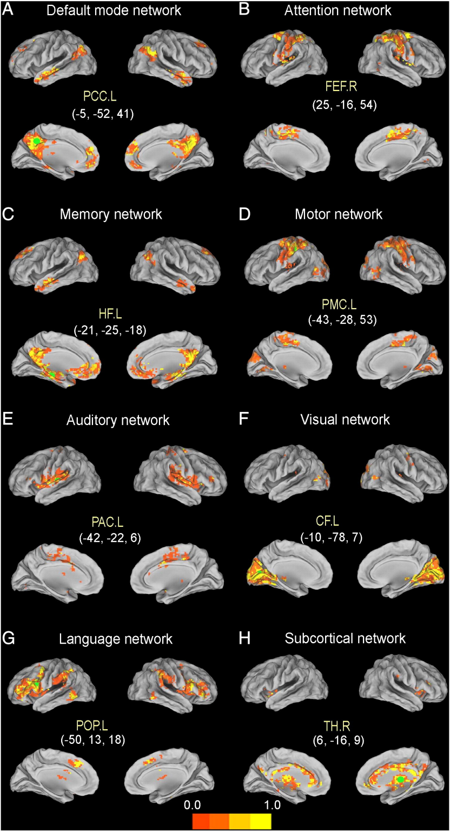
The probability distribution of D-RSFC strength.
The strength probability distribution maps of the default-mode, attention, memory, motor, auditory, visual, language and subcortical networks during the resting state.
The green circle of each map shows the coordinates of the ROI. The different color-coded voxels in each network indicate different connectivity strengths with the ROI.

Slide 17
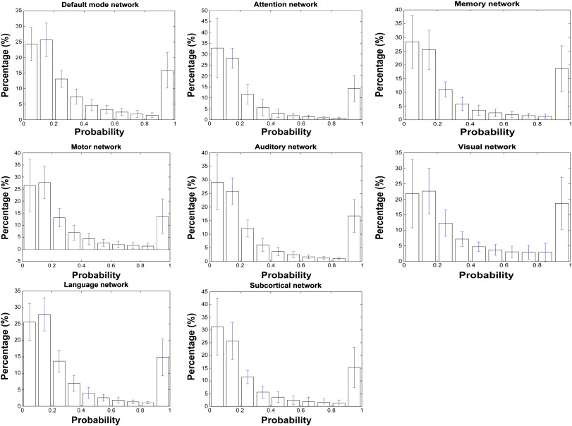
The percentage of connectivity strength of each network is shown as an interval of 0.1. The probability means the number of time points at which regression coefficient was significantly different from zero, divided by the total number of time points
Notes:
There were only 10-20% of the voxels with strong connectivity

Slide 18
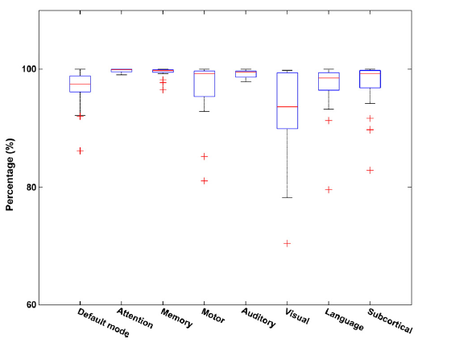
Stability of strong functional connectivity across subjects
This boxplot shows median, interquartile, and range for the percentages of the group of subjects. The stability percentage of voxelsthat have strong connectivity with the ROIs was almost 100%.

Slide 19
D-RSFC maps spatial similarity between different time points
For each network – Kandall’s Coefficient of concordance (KCC) was calculated across subjects
KCC quantifies the similarity of a network across time
Ri = sum rank of the ith voxel within the network
n = number of voxels within the S-RSFC maps
= ((n+1)K)/2 is the mean of Ri
K = number of TRs (here 230)
Χ² = K(n-1)W The KCC of one network is an average over all sujects

Slide 20
Spatial similarity of D-RSFC maps across time

Slide 21
Spatial similarity between D-RSFC and S-RSFC maps

Slide 22
Analyzing relationships between networks

Slide 23
Discussion
The application of a novel method (VPR with Kalman filtering) revealed dynamic functional connectivity both within and between multiple cognitive networks
The observed dynamic connectivity suggests the traditional linear measurement may not entirely reflect the interactions between brain regions
Comparison against sliding window approach claim to perform better in noise suppression and accurate estimation within the interval between noise and sine part (fig missing – no results shown).

Slide 24
Comments
Some supplementary figures were not to be found
Claim to introduce a method – this method has already been used in the exact same manner on another type of fMRI experiment.
I did not see support in results for inter-network connectivity dynamics

