Slide 1
Speeding up the Consensus Clustering methodology for microarray data analysis
AMB Review 11/2010

Slide 2
Consensus Clustering (Monti et al. 2002)
Internal validation method for clustering algorithms.
Stability based technique.
Can be used to compare algorithms or for estimating the number of clusters in the data. We will focus on the second task.

Slide 3
Preliminaries
We are given a gene expression matrix D and we want to cluster the genes.
We will use the Euclidean distance as pair wise dissimilarity score between genes patterns. (data is standardized by genes)
Representing a clustering solution – “Connectivity matrix” - M(i; j) = 1 if items i and j are in the same cluster and zero otherwise.
We will focus on hierarchical clustering algorithms.

Slide 4
Consensus Clustering
Procedure Consensus(Sub;H;D;A; kmax)
Sub: a re-sampling scheme
H: the number of re-sampling steps
D: the data
A: a clustering algorithm
Kmax: maximum number that is considered as candidate for the correct number of clusters in D

Slide 5
Consensus Clustering
For 1< k <= kmax:
For 1 <= h < H, compute a perturbed data matrix D(h) using re-sampling scheme Sub; cluster the elements in k clusters using algorithm A and D(h) and compute a connectivity matrix M(h).
Based on the connectivity matrices, compute a consensus matrix M(k)
Based on the kmax - 1 consensus matrices, return a prediction for k.

Slide 6
The consensus matrix
The consensus matrix M(k) is defined as a properly normalized sum of all connectivity matrices in all sub-datasets.

Slide 7
Estimating the correct K
Choose the “knee” of the distribution: the first k that start the stabilize phase of the delta curve.
For Hierarchical clustering algorithms this score is non negative, when negative values are observerd a common correction is to change A to:

Slide 8
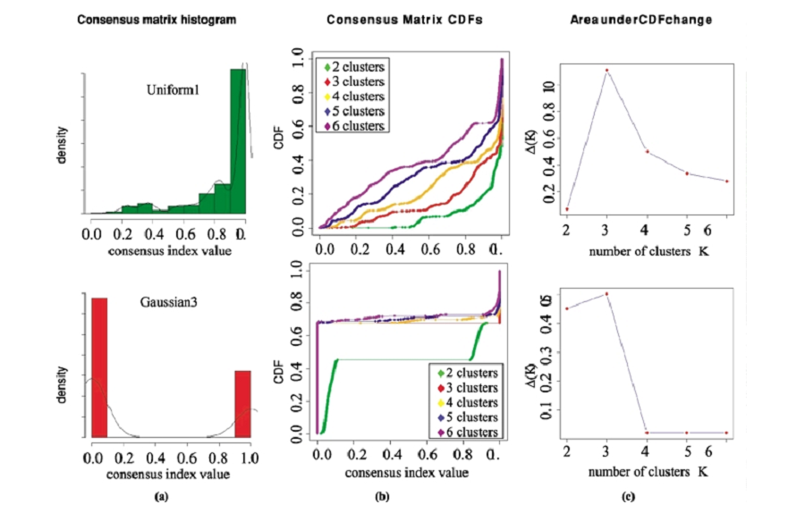
Estimating the correct K
Notes:
Uniform1 is generated from a uniform 600-dimensional hypercube. Dataset
Gaussian3 represents the union of three Gaussian distributions in a 600-dimensional space
(a) – results for k=3.

Slide 9
Procedure FC(Sub;H;D;A; kmax)
For 1 <= h <= H, compute a perturbed data matrix D(h) using resampling scheme Sub.
For 1 < k <= kmax, initialize to empty the set M(k) of connectivity matrices and cluster the elements in k clusters using algorithm A and D(h). Compute a connectivity matrix M(h;k).
For 1 < k <= kmax, based on the connectivity matrices, compute a consensus matrix M(k).
Based on the kmax -1 consensus matrices, return a prediction for k.

Slide 10
FC
When A is a hierarchical clustering algorithm, running time can be reduced significantly. (A runs H times instead of H*Kmax)
Connectivity matrices for k are built based on the connectivity matrices of k+1.
Uses the same rule for deciding the correct K as consensus.
Applicative for both top down and bottom up clustering methodologies.

Slide 11
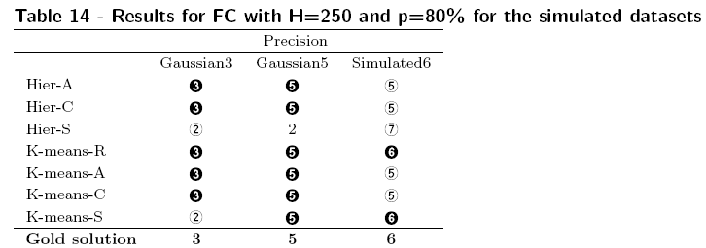
FC vs. Consensus

Slide 12
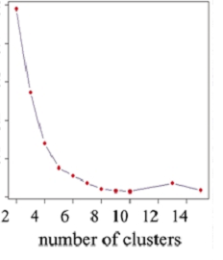
WCSS
Within clusters sum of squares.
For 1<k<Kmax compute the
wcss score. This score decrease
as k increases.
Choose the first k that satisfies:
WCSS(k)-WCSS(k+1) < ε .
Alternatively one can use the same
Approaches that consensus uses for determining the
“knee”.

Slide 13
FOM (Yeung et al. 2001)
Figure Of Merit – methods that use jackknife sampling for assessing the predictive power of a clustering algorithm.
The idea: apply the clustering algorithm to the data from all but one experimental condition. The clusters should exhibit less variation in the remaining condition than clusters formed by chance. This predictive power is quantified using the “figure of merit” score.

Slide 14
FOM (Yeung et al. 2001)
Notations:
e- the condition used for estimating the power.
R(g,e)- the expression level of gene g under condition e.
C1,…,Ck – a clustering solution.
μ(i,e) – the average expression of cluster i in condition e.
FOM(e,k)- the mean error of predicting the expression levels.

Slide 15
FOM (Yeung et al. 2001)

Slide 16
GAP statistic (Tibshirani et al. 2001)
A statistic based on the difference between the WCSS score on the input data and the same quantity obtained after randomly permuting the genes within each condition.
Return the first K such that :

Slide 17
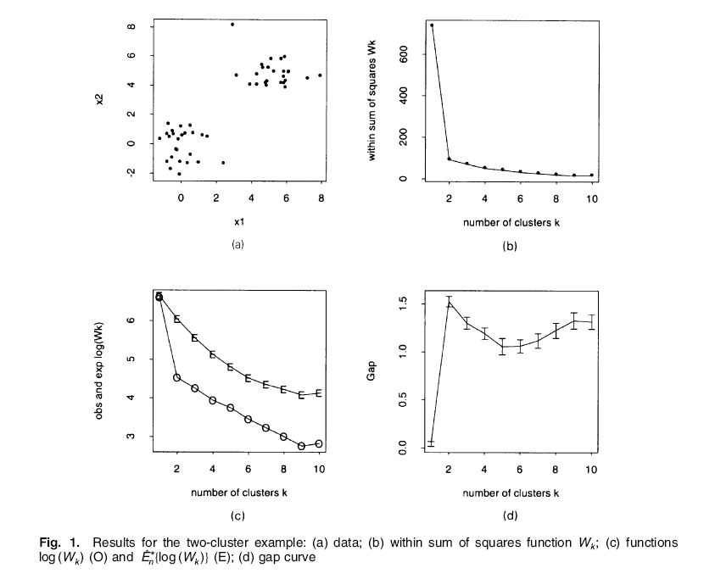
GAP statistic

Slide 18
CLEST (Breckenridge 1989)
As Consensus it is a stability based technique.
A sketch of the algorithm:
Randomly divide the data into a training set T and a test set S.
Cluster T and assign each element in S to a cluster in T, use this clustering of S as a “gold solution”.
Cluster S and compare this solution’s consistency with the gold solution using some measuring method E.
Repeat these steps several times and return the average\median E score.

Slide 19
CLEST (Breckenridge 1989)
Random E scores can be calculated using permuted\simulated data sets.
Using the random scores empirical p-values can be calculated.
K with the most significant p-value is chosen.

Slide 20
Clustering algorithms
Hierarchical clustering:
Kmeans with or without hierarchical clustering solution as a starting point (Kmeans, Kmeans-R, Kmeans-C, Kmeans-S).
NMF: Non negative Matrix Factorization, can also use another algorithm’s solution as a starting point(NMF, NMF-R, NMF-C, NMF-S)
Formula | Linkage type | Name
 | Average | Hier-A
 | Complete | Hier-C
 | Single | Hier-S

Slide 21
NMF
An unsupervised learning paradigm in which a non-negative matrix (NM) V is decomposed into two NM matrices W,H by a multiplicative updates algorithm (for example EM implementation).
V ≈ WH
V = n x m (n=No. of Genes, m= No. of conditions)
W = n x r (r = No. of Meta-Genes)
H = r x m

Slide 22
NMF
For GE data we can interpret this process by the following underlying model: assume that there are r meta-genes and every real gene expression pattern is linear combination of the meta genes patterns.
W quantifies the meta-genes coefficients and H is the meta-genes expression pattern matrix.
For Clustering analysis assign each gene to the meta gene that has the largest influence (the largest coefficient).

Slide 23
Data Sets
Data set | No. of clusters | No. of genes | No. of conditions
CNS Rat (Wen et al. 1998) | 6 | 112 | 17
Leukemia (Golub et al. 1999) | 3 | 100 | 38
Lymphoma (Alizadeh et al. 2000) | 3 | 100 | 80
NCI60 (2000) | 8 | 200 | 57
Normal (Su et al. 2002) | 4 | 1277 | 90
Novartis (Ramaswany et al. 2001) | 13 | 1000 | 103
PBM(Hartuv et al. 2000) | 18 | 2329 | 139
St.Jude(Yeoh et al. 2002) | 6 | 985 | 248
Yeast(Spellman et al. 1998) | 5 | 698 | 72
Gaussian 3 | 3 | 600 | 60
Gaussian 5 | 5 | 500 | 2
Gaussian 6 | 6 | 600 | 60

Slide 24
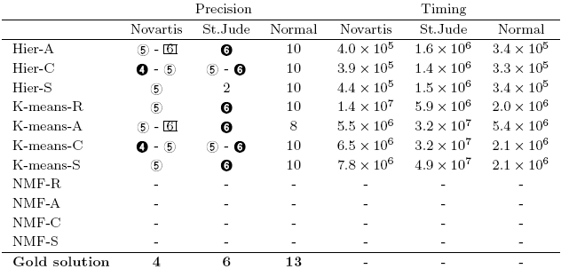
Results
FC Results:
Consensus Results:

Slide 25
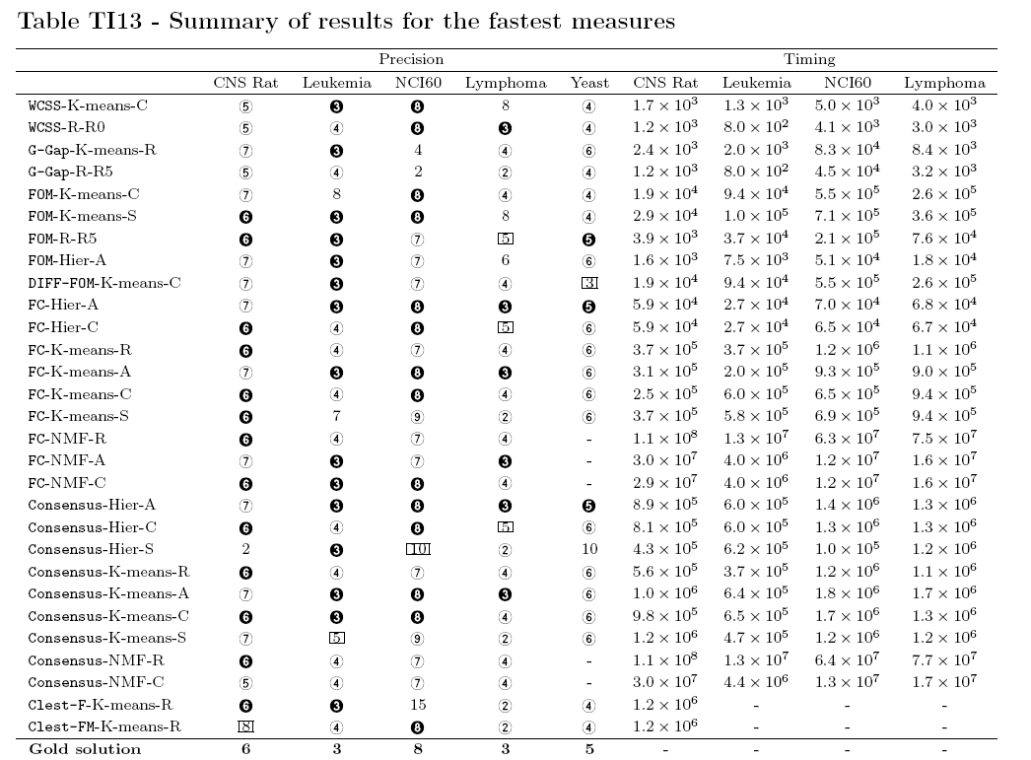
Results

Slide 26
Results

Slide 27
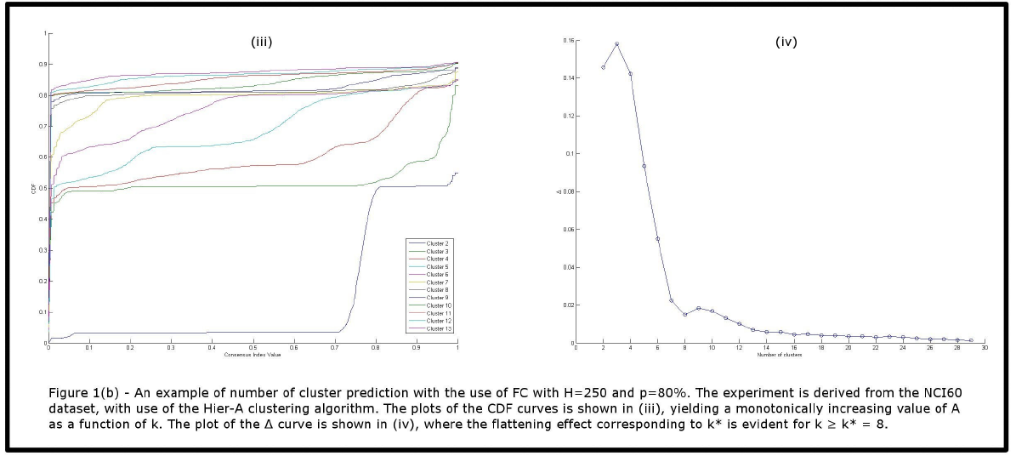
Results

Slide 28
Pros
Experimental results:
NMF’s limitations when used as clustering algorithm.
different parameters for Consensus.
Consensus distance is at least as good as Euclidean.
FC is fast and precise. The results are almost identical to Consensus’s results.
Very nice implementation for the algorithms with GUI, All data sets are available from the supplementary site.

Slide 29
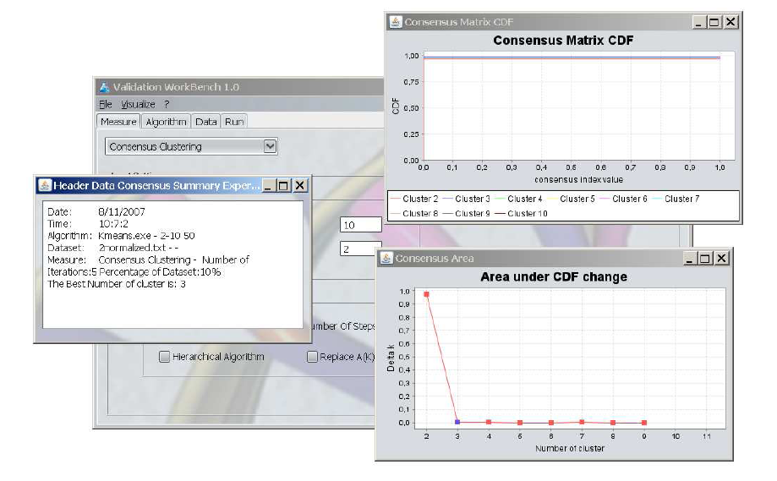
Pros

Slide 30
Cons – Practical results problems
Data sets CNS Rat, Leukemia, Lymphoma and NCI60 are very small (200 or less genes) and obsolete (published between 1998 and 2000)
Missing results for G-Gap, GAP, WCSS,FOM and CLEST on 7 data sets - Normal, Novartis, PBM, St. Jude, Gaussian 3, 5 and 6.
There are known algorithms for computing the “knee” of a curve (known as the L-shape algorithm), it seems that no such algorithm was tested here.

Slide 31
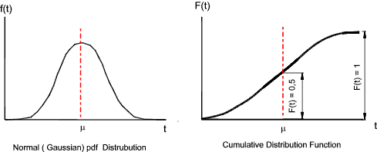
Cons – Theoretic Questions
It is not obvious that increase in the cdf AUC is good, what is the AUC for random clustering? What is the AUC when the real data is composed of one true big cluster and several small clusters?

Slide 32
Cons – Theoretic Questions
Consensus and FC number of re-sampling parameter. Even in consensus it seems problematic that the number of repetitions for each algorithm is very low while it estimates high number of parameters. FC seems even more problematic since the sampling is done once.
Problematic comparison with the GAP statistic.

