Slide 1
OrenTzfadia>_
FISHING FOR NOVEL CAROTENOID BIOSYNTHESIS RELATED GENES

Slide 2
Presentation Outline
OrenTzfadia>
Carotenoid Biosynthetic Pathway
Arabidopsis EXPANDER work
Rice EXPANDER development
Possible co-expression networks analysis with AMADEUS

Slide 3
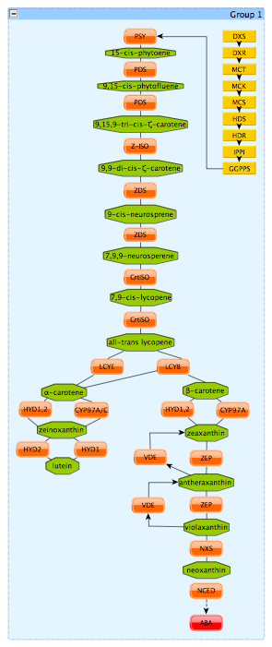
What are carotenoids?
OrenTzfadia>
Structure: 40 carbon chain backbone –plant pigments.
Functions in plants
Light harvesting complex in photosynthesis
Protect against oxidative damage caused by high light
Precursor to plant hormones such as ABA and strigolactons

Slide 4
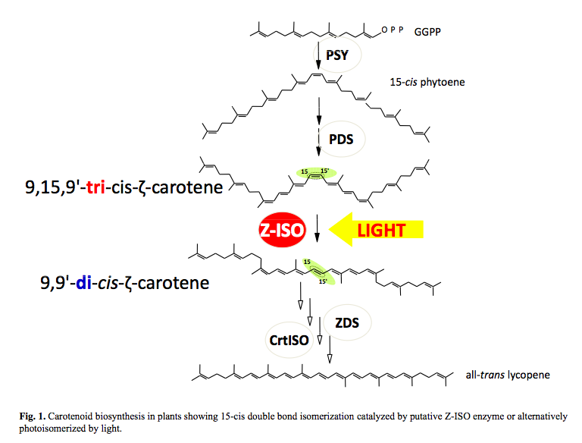
(finding more) Missing pieces of the puzzle
OrenTzfadia>
(Yu et al., 2010)

Slide 5
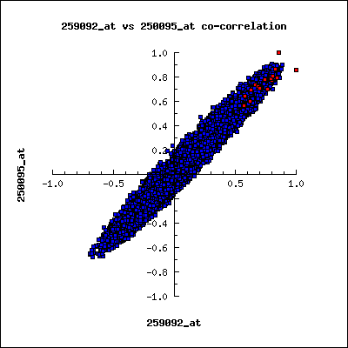
OrenTzfadia>_ {
Correlated expression in Arabidopsis over 300 microarray experiments suggests coordinate regulation }
Carotenoid pathway genes show
correlated expression
PSY
ZDS
(Tzfadia & Wurtzel, unpub.)
Arabidopsis co-expression tool (ACT) (http://www.arabidopsis.leeds.ac.uk/)
Notes:
Correlation of expression among pathway genes must be shown if global pathway regulators exist. We used PSY as the driving gene in expression correlation analysis against the entire genome for expression (transcript levels) averaged across ~400 stimulus conditions and developmental stages, and identified ZDS as the top correlating pathway gene. The correlation (r) values for the entire genome were plotted against those for PSY and ZDS (Fig. 2). Group A genes shown in the figure illustrate the strong correlation among the carotenoid pathway genes indicated by the red dots. These results suggest the presence of global transcriptional regulators that
TOOL: Arabidopsis co-expression tool (ACT) (http://www.arabidopsis.leeds.ac.uk/) control co-expression.
Figure. Pathway genes show correlated expression. Scatter plot shows expression correlation (r-value) of all Arabidopsis genes relative to PSY and ZDS. Red dots are carotenoid-associated genes (A).

Slide 6
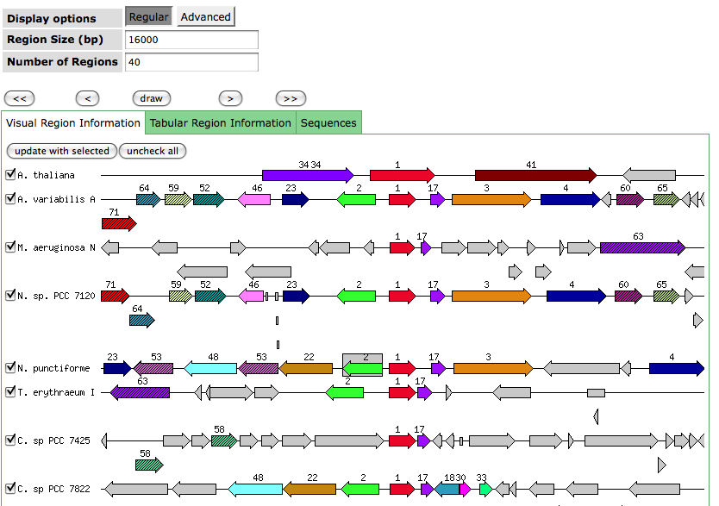
Carotenenoid terms
carotenoid
phytoene
neurosporene
lycopene
zeaxanthin
hopene
lutein
geranyl
farnesyl
squalene
spheroidene
spirilloxanthin
xanthin
bacteriochlorophillide
crtV
crtT

Slide 7
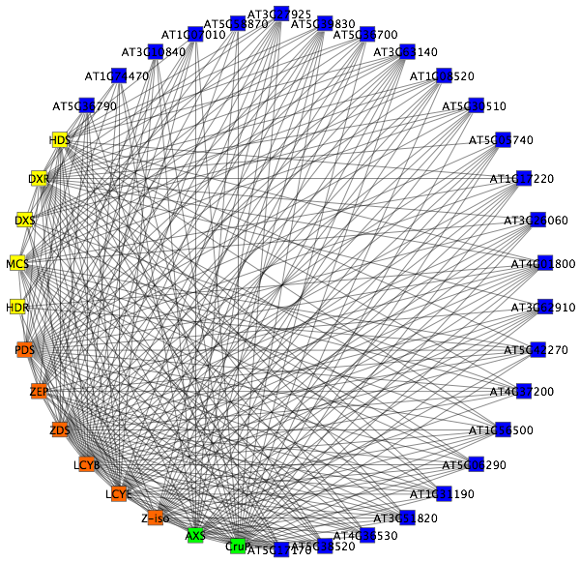
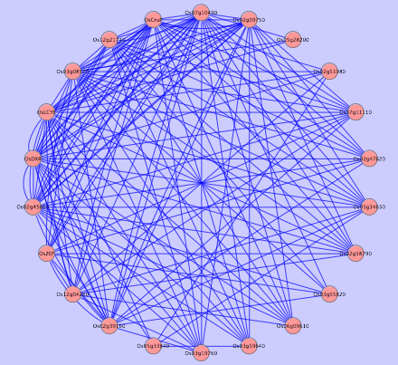
Notes:
LABLE

Slide 8
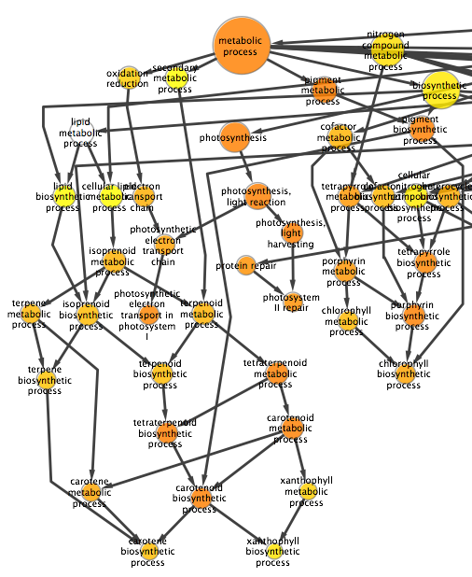
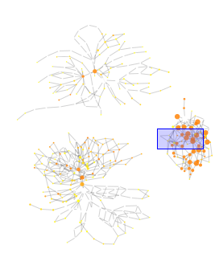
OrenTzfadia>
Nodes: 410
Edges: 632
Notes:
Lable figure

Slide 9
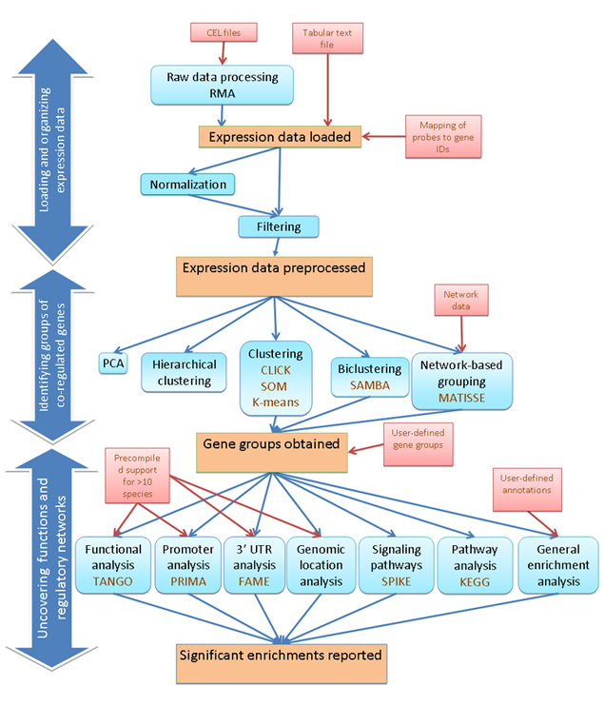
EXPANDER
OrenTzfadia>
(Ulitsky et al, 2010)

Slide 10
Microarry experiments I collected (~ 100 exp.)
PLANT HORMONES
ABA
Brassinosteroids
Citokinins
Physiological conditions
Light
Biotic stress
Abiotic stress
Experiments types
Treatment elicitation
Wt Vs mutant
Time course

Slide 11
EXPANDER Probe filtering
OrenTzfadia>
Most fold changed
Variation
- Signal intensity
User custom probe set (CBRG/TFs/un-annotated genes)

Slide 12
BiClustering – over 47 conditions
filtered probes that display at least 1.5 fold change in at least 15 conditions
>> 11,595 probes survived.
Only 6 carotenoid genes and 6 candidates
have survived this filter.

Slide 13
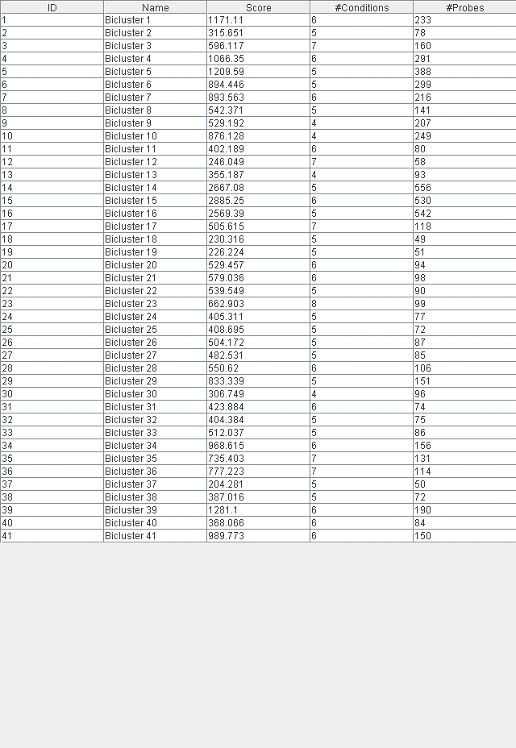
SAMBA

Slide 14
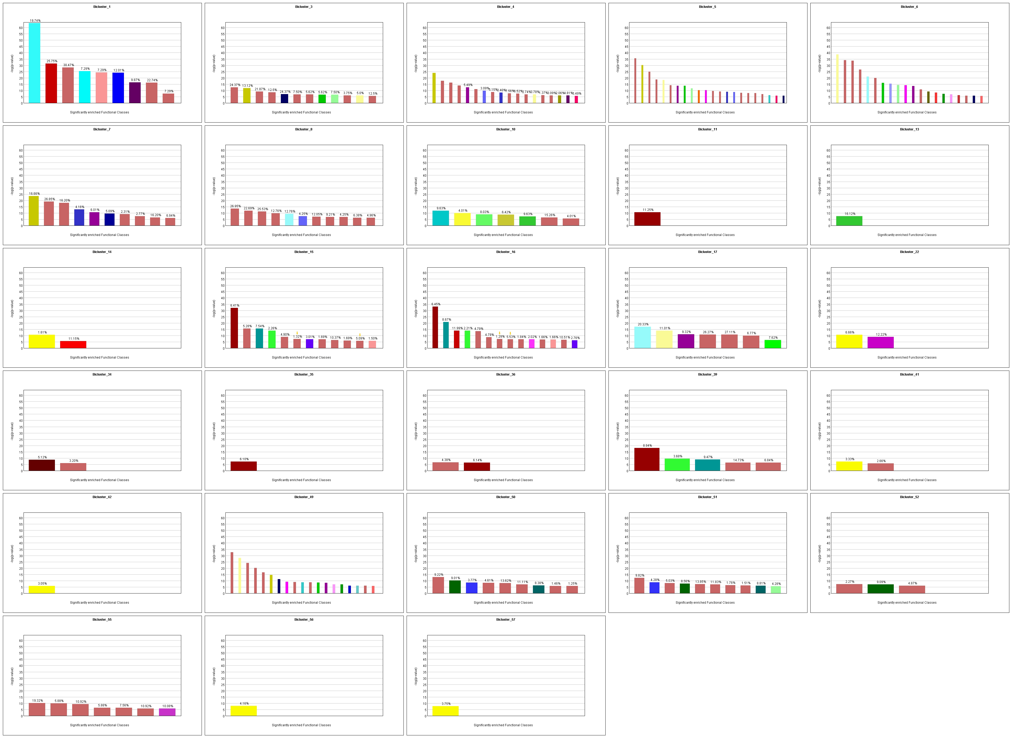
TANGO

Slide 15
‘HOT BICs’
BICs 15,16 (light conditions) contains only PSY, CRTiso, ZEP, DW27 and 6 candidate genes.

Slide 16
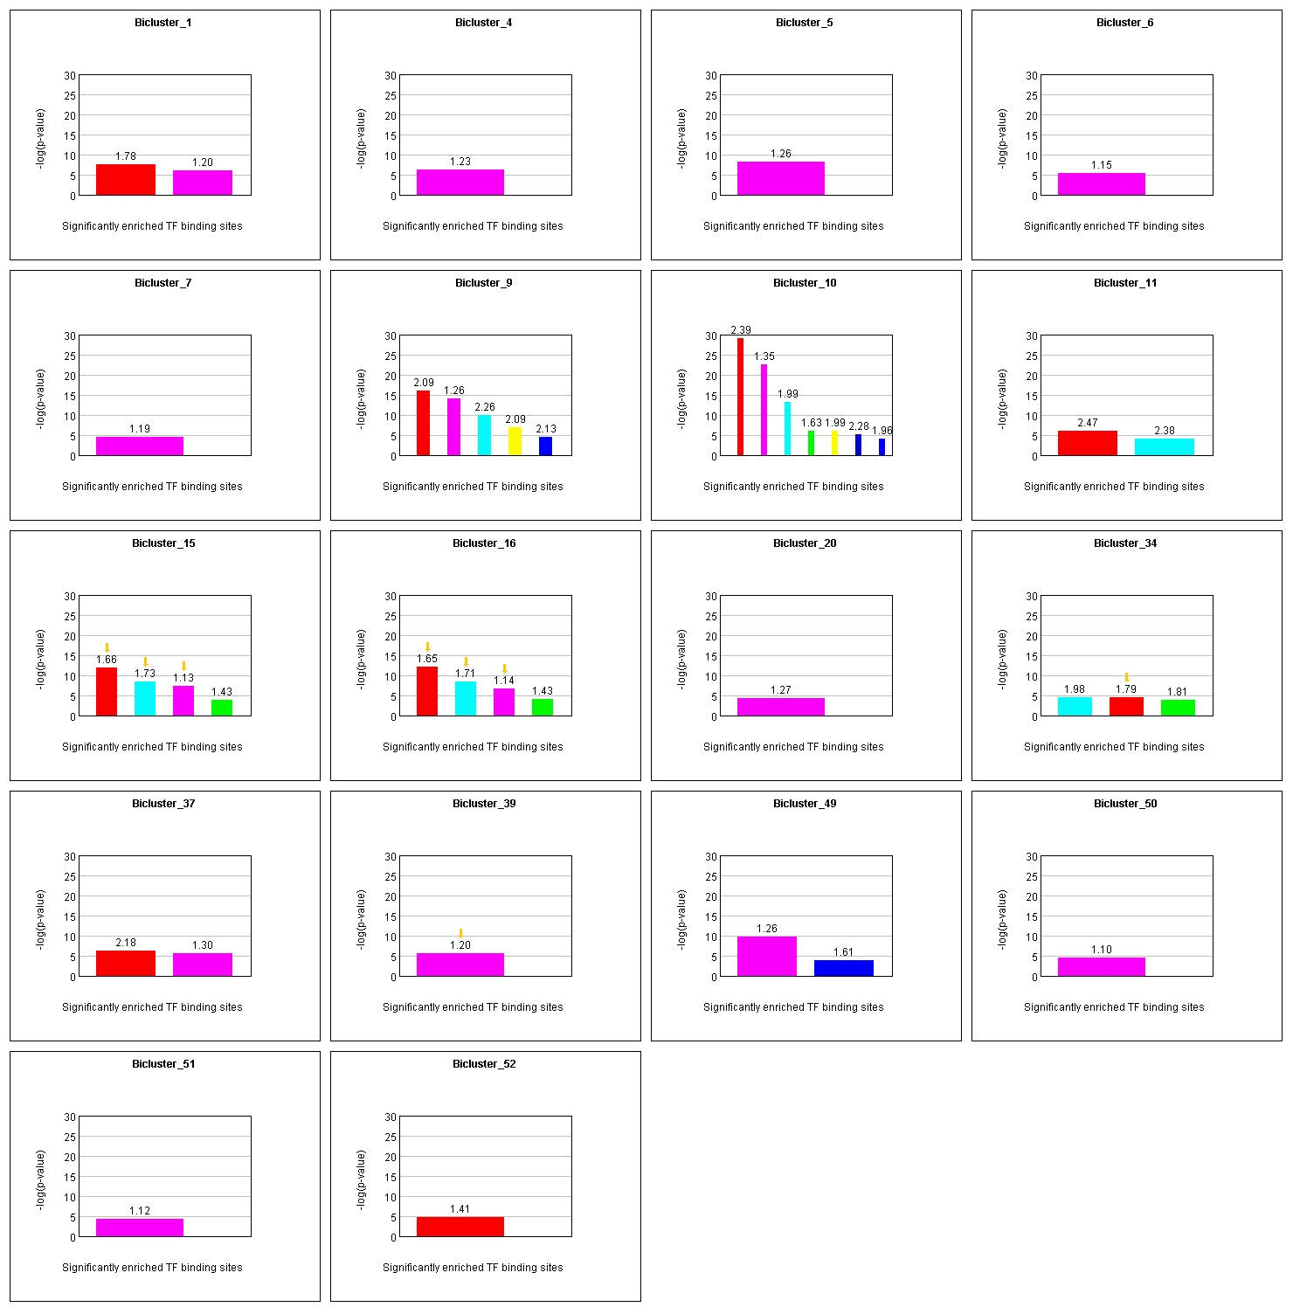
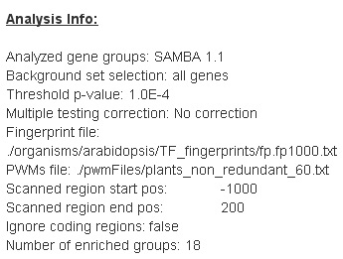
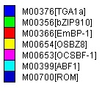
PRIMA

Slide 17
PRIMA – BICs 15 and 16

Slide 18
Light experiment as benchmark
Light is known to induce the carotenoid genes since they play key role in the photosynthesis process.
Raw data contains - 22,747 probes
Filtering by signal intensity – 12,650 probes survived.
SAM filter(FDR estimation <0.05) – 4080 probes survived.
Genes Of Interest (GOIs):
Carotenoid genes – 52
Novel carotenoid candidates genes – 24
Total GOIs – 76
After filtering:
19 carotenoid + 12 candidates genes survived (p-value 2.63895E-06)
Acknowledgments: Didi Amar

Slide 19
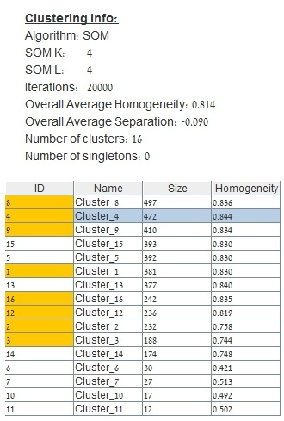
Light experiment as benchmark – SOM clustering

Slide 20
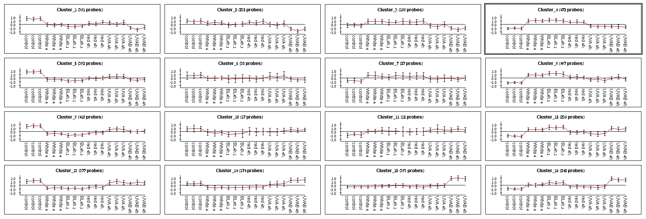
Light experiment as benchmark

Slide 21
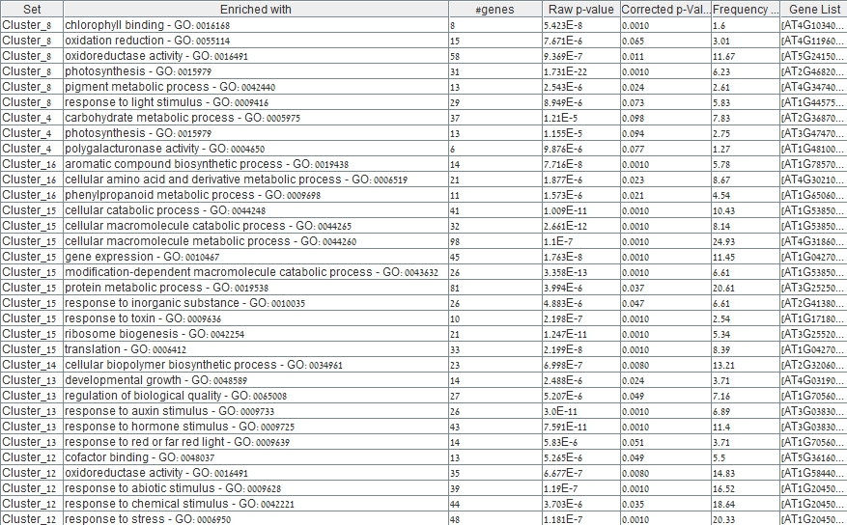
Light experiment as benchmark- GO enrichments

Slide 22
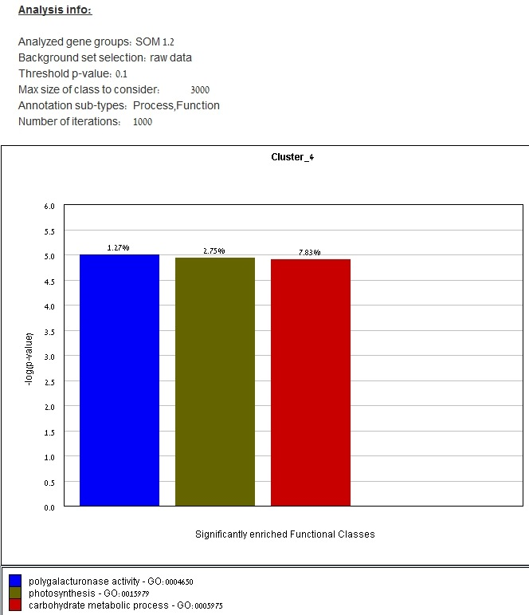
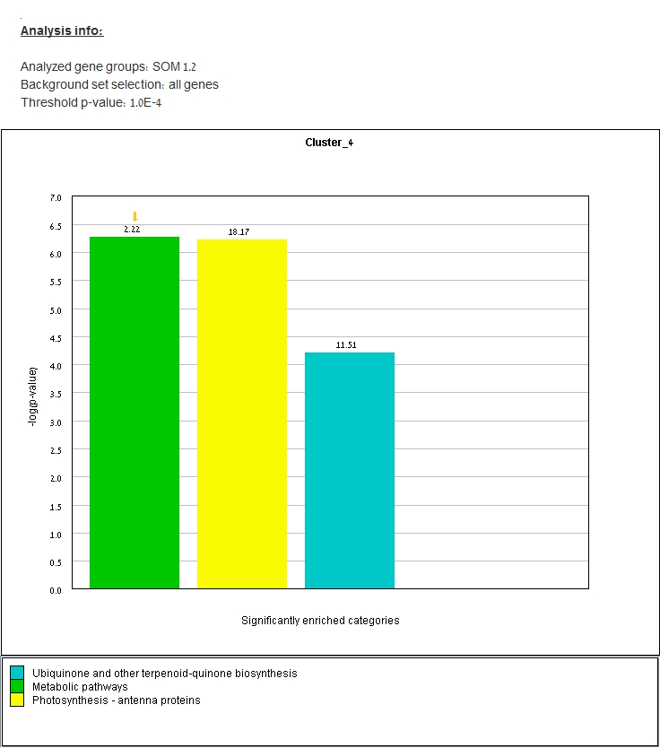
Light experiment as benchmark – cluster 4
TANGO
KEGG

Slide 23
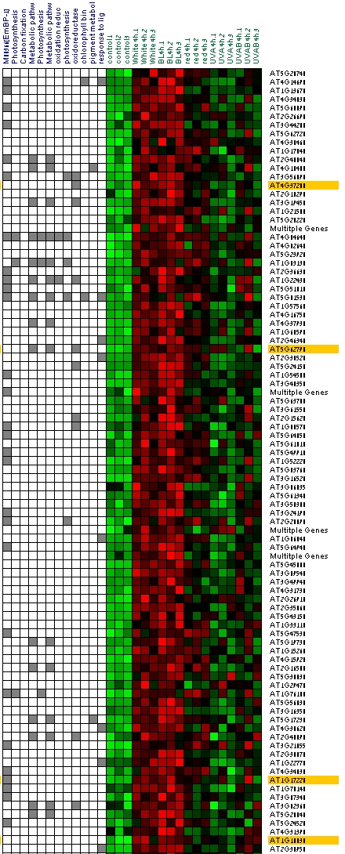
Light experiment as benchmark – cluster 4

Slide 24
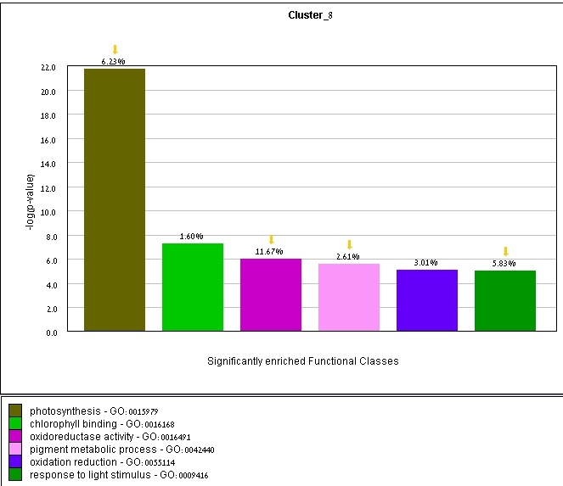
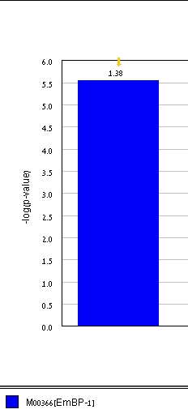
Light experiment as benchmark- cluster 8
KEGG
KEGG
TANGO
PRIMA

Slide 25
Light experiment as benchmark- Results Summary
Cluster 4
Carotenoid genes | LCYB, VDS, NXS, CruP
Candidates genes | AT3G63140 | Encodes a protein with ribonuclease activity that is involved in plastid rRNA maturation
Cluster 8
Carotenoid genes | DXR, PSY, PDS, Ziso, CYP97A, ZEP
Candidates genes | AT1G17220 | encodes a chloroplast-localized protein with similarity to translation initiation factor 2
 | AT1G56500 | haloacid dehalogenase-like hydrolase family protein
 | AT4G36530 | hydrplase alpha/beta fold family protein
 | AT1G31190
 | AT1G07010
 | AT3G27925
 | AT4G37200
Notes:
AT5G17170

Slide 26
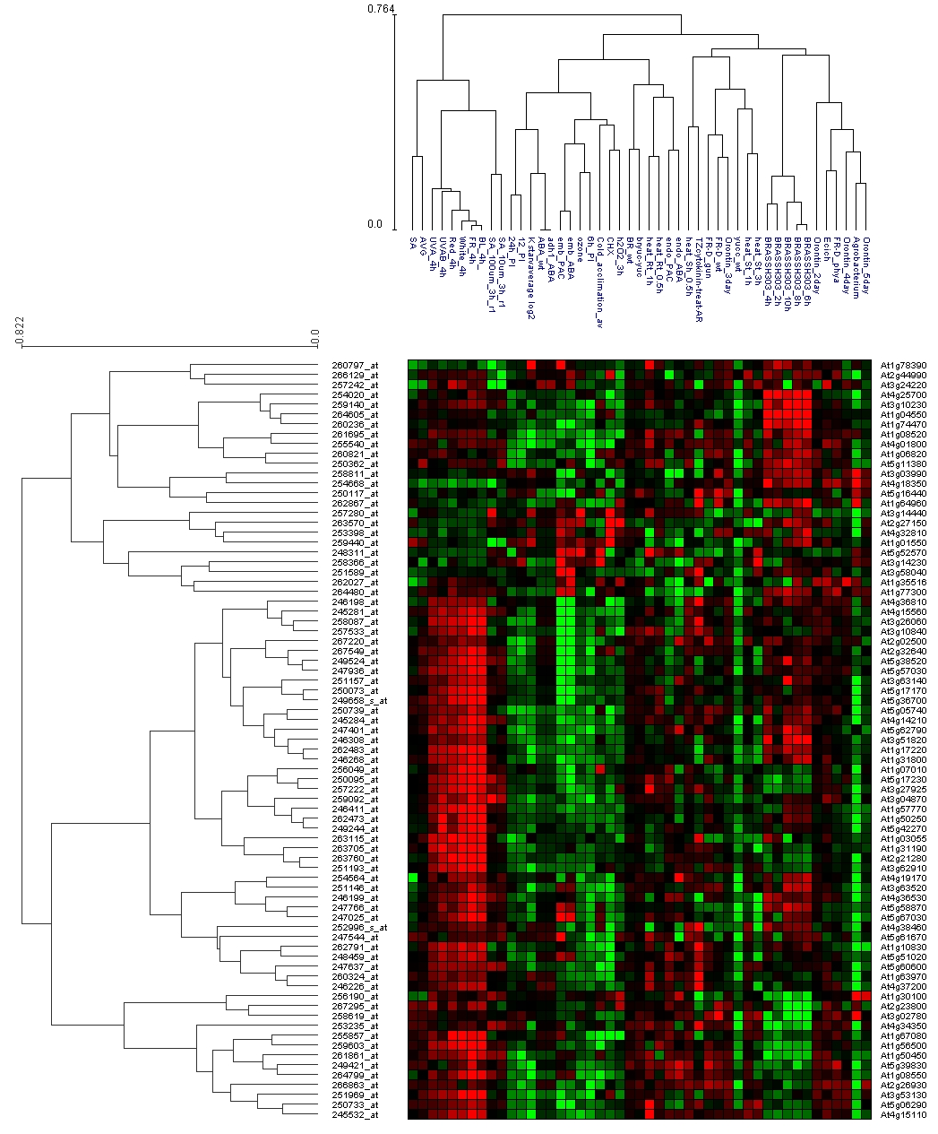
Hierarchical Clustering
Data will be tested using the ISA algorithm
Acknowledgments:
Renana Maller

Slide 27
Arabidopsis thaliana -> Rice project with Adi Maron-Katz
OrenTzfadia>
Dicots Vs Monocots
We may want to extend EXPANDER to support rice data.
This will allow plant researchers to identify conserved regulatory mechanisms between Arabidopsis and the staple crop Oryza sativa
So far we have installed the GO terms files for rice and running tests on the system. We also collected the rice promoters files.

Slide 28
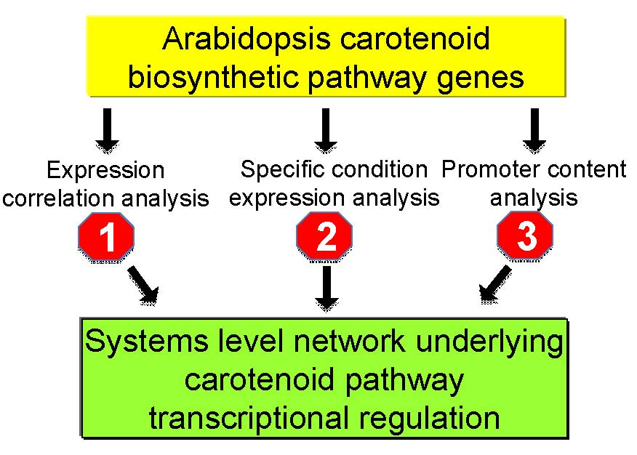
OrenTzfadia>_

Slide 29
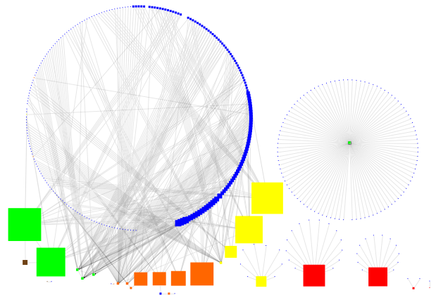
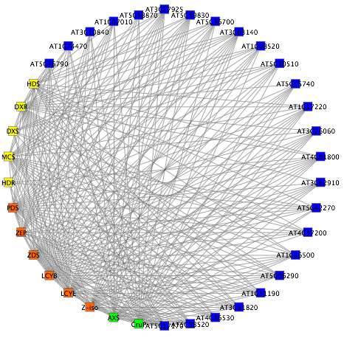
A.
B.
C.
B.
Correlation co-expression networks in Arabidopsis and rice.
A. Co-expression correlation analysis of ~30 Carotenoid biosynthesis related genes against the rest of the genome Arabidopsis (r-value >0.85).
B. Co-expression correlation network of Arabidopsis carotenoid related genes and their co-expressed genes (r-value >0.85) that have bacterial homologs with adjacent genes that contain ‘carotenoid related terms’, in their annotation.
C. The rice orthologe co-expression network of carotenoid related genes and their co-expressed genes (r-value >0.85) that have bacterial homologs with adjacent genes that contain ‘carotenoid related terms’, in their annotation.

Slide 30
Promoter Content Analysis - Building the Data Set
OrenTzfadia>
Identification of top 50 genes co-expressed with each of the carotenoid biosynthetic related genes [r-value > 0.85)
Extract promoter regions
Run in promoter content analysis algorithm
(AMADEUS)
Notes:
ftp://ftp.arabidopsis.org/home/tair/Genes/TAIR8_genome_release/TAIR8_sequences/

Slide 31
Thank you!

